Slide 1



A320 FFS
Maintenance Technician
Training Course
Prepared By: Mohamed Sakr
Systems – Diamond Diagnostics
Thales Training & Simulation

Slide 2

Notes:
4 System Diamond

Slide 3
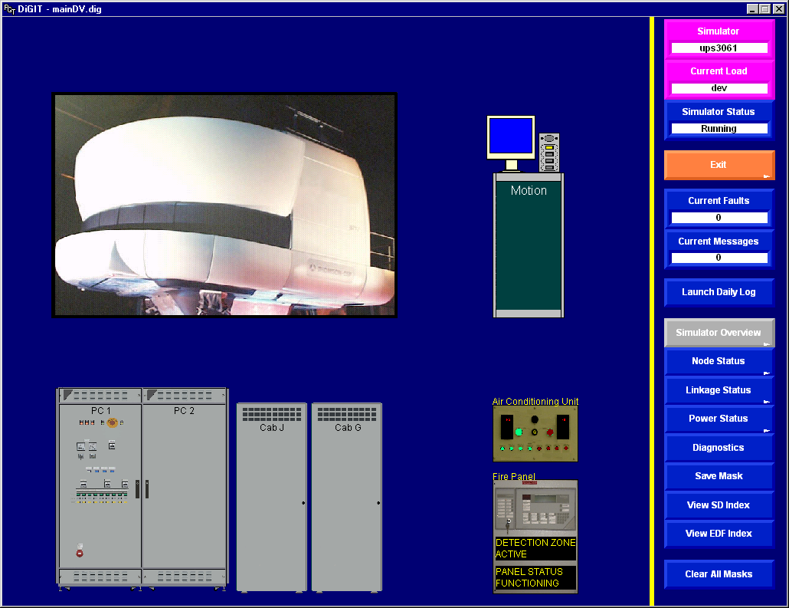
Notes:
4 System Diamond

Slide 4
Notes:
4 System Diamond

Slide 5
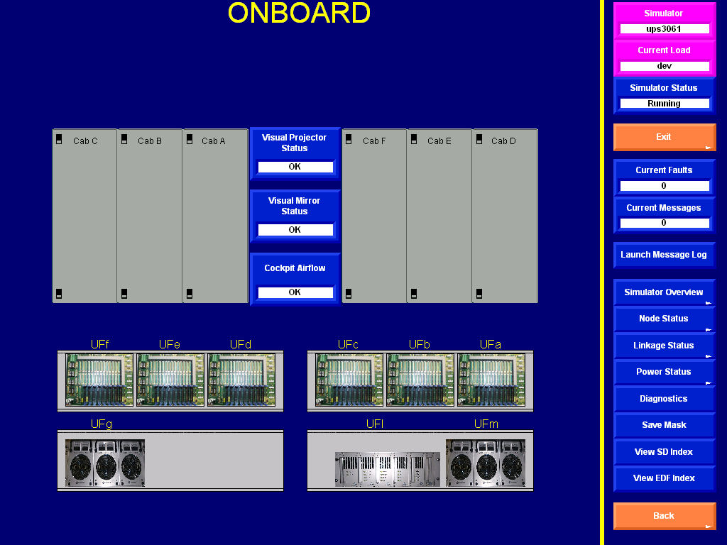
Notes:
4 System Diamond

Slide 6
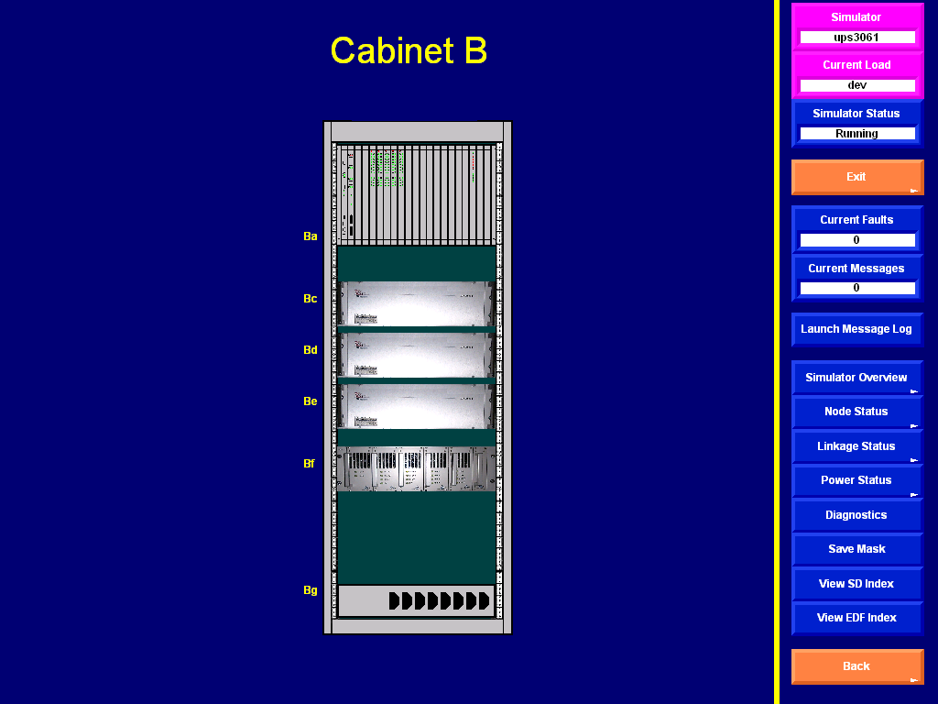
Notes:
4 System Diamond

Slide 7
Notes:
4 System Diamond

Slide 8
Notes:
4 System Diamond

Slide 9
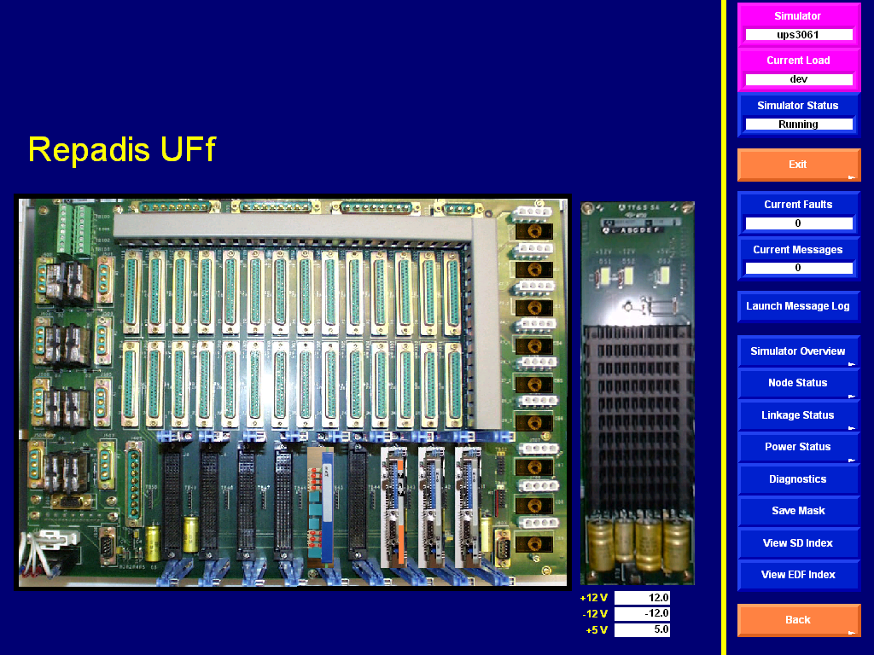
F
A
I
L
Notes:
4 System Diamond

Slide 10
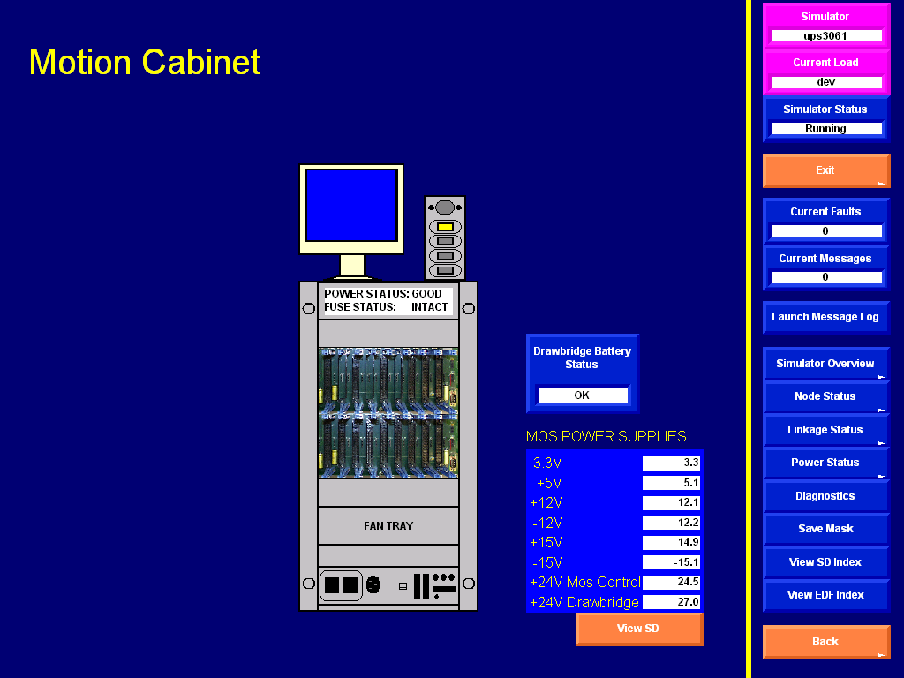
Notes:
4 System Diamond

Slide 11
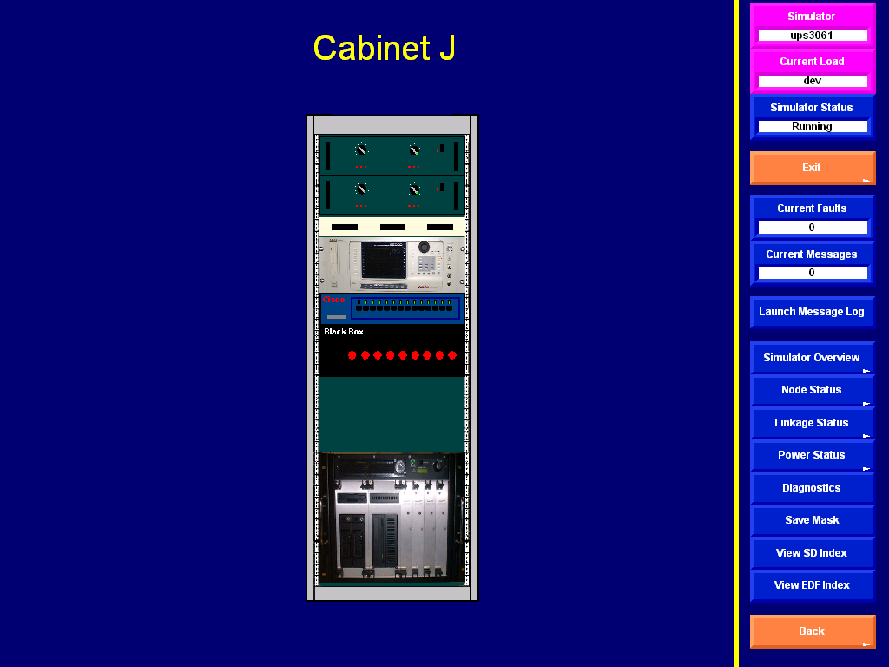
Notes:
4 System Diamond

Slide 12
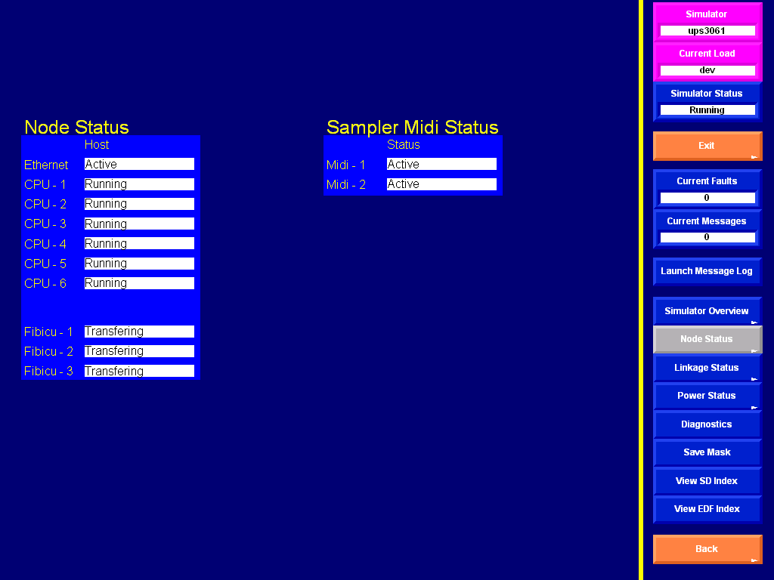
Notes:
4 System Diamond

Slide 13
Notes:
4 System Diamond

Slide 14
Notes:
4 System Diamond

Slide 15
Notes:
4 System Diamond

Slide 16
Notes:
4 System Diamond

Slide 17
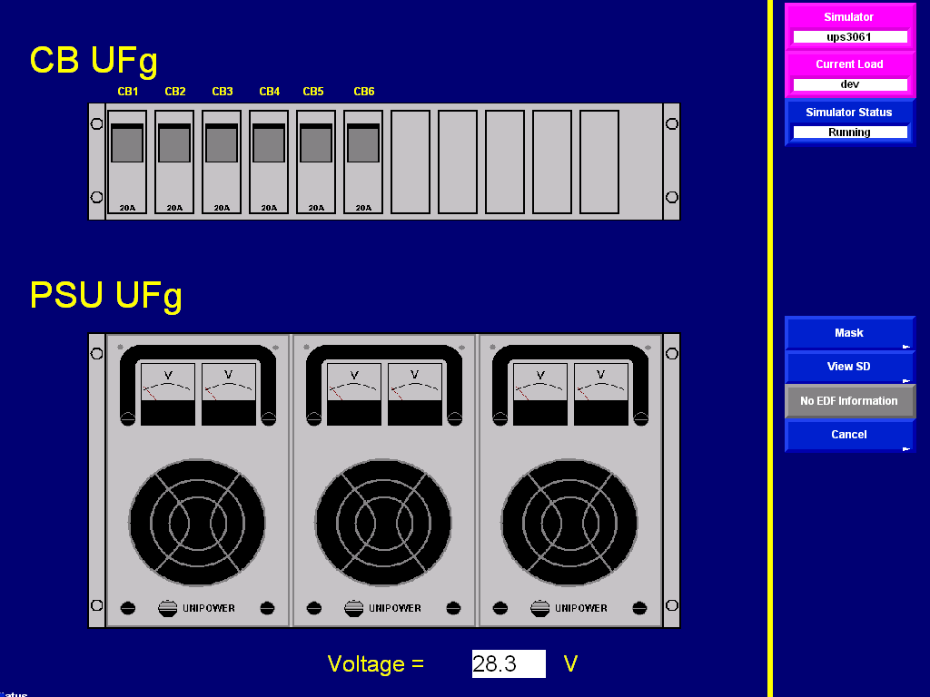
Notes:
4 System Diamond

Slide 18

Notes:
4 System Diamond

Slide 19


References : THALES STD simulator Manufacture manual .
?
Please Feel free to Ask
Practical

